Slide 1
Building the IRS 990 E-Filer Database
Jesse D. Lecy
Nonprofit Open Data Collection
May 23, 2017

Slide 2
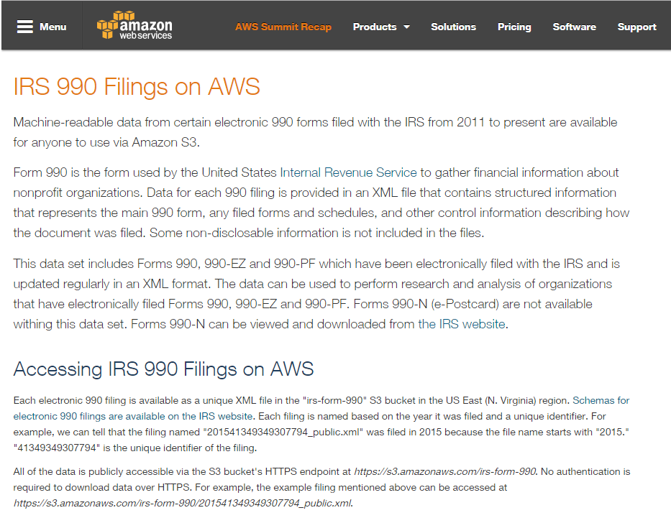
Amazon Web Server Page

Slide 3
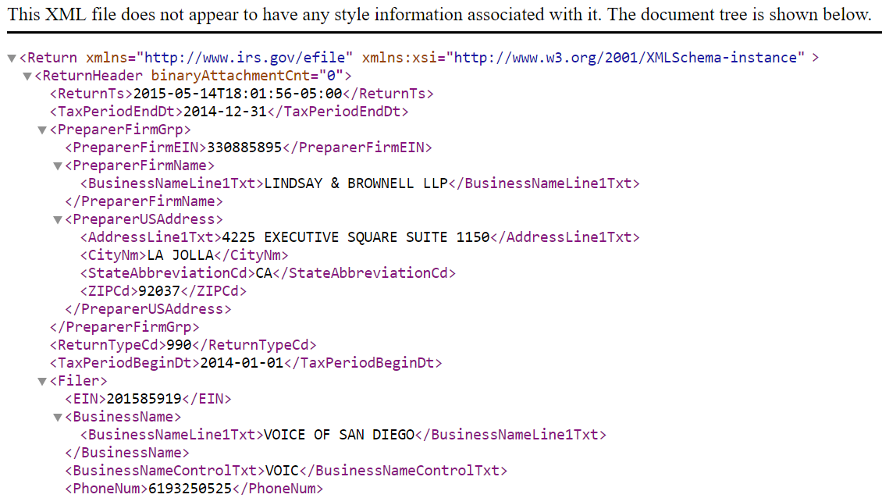
XML Documents

Slide 4
XPATHs
“Path” (address in XML doc)
Variable Name
"//Return/ReturnData/IRS990/CYProgramServiceRevenueAmt
Data in XML File

Slide 5
EXAMPLE: Current Year Program Service Revenue
## COPY AND PASTE XPATHS FROM IRS SPREADSHEET
V_990CPSRpost2013 <- "//Return/ReturnData/IRS990/CYProgramServiceRevenueAmt"
V_990CPSRpre2013 <- "//Return/ReturnData/IRS990/ProgramServiceRevenueCY"
V_990CPSR.EZpost2013 <- "//Return/ReturnData/IRS990EZ/ProgramServiceRevenueAmt"
V_990CPSR.EZpre2013 <- "//Return/ReturnData/IRS990EZ/ProgramServiceRevenue"
psr.current.xpath <- paste( V_990CPSRpost2013, V_990CPSRpre2013,
V_990CPSR.EZpost2013, V_990CPSR.EZpre2013, sep="|" )
## GRAB THE DATA FROM THE XML DOC
PSRCURRENT <- xml_text( xml_find_all( doc, psr.current.xpath ) )
## STANDARDIZE THE DATA THROUGH PRODUCTION RULES
PSRCURRENT <- changeMissingToZeros( PSRCURRENT )
4 Versions of the Same Variable:
PC and EZ; Pre and Post 2013 Changes

Slide 6
Workflow
After your team has selected a section of the 990 Form or Schedule to work with,
Select a specific field from the 990 form
Identify the twin field on the 990-EZ form, if it exists (ignore this step for Schedules)
Create a descriptive variable name (for example, TOTREV for total revenue)
Append the appropriate prefix to the name (see below – e.g. F9-PZ-03)
Create a clear definition of the variable using info from the 990 form and your knowledge of nonprofits
Identify all of the relevant xpaths associated with the field
Document the location(s) of the variable on the appropriate forms or schedules using a location code (see below)
Copy the “Version” info from the “Master Xpath” spreadsheet
Record any relevant notes and questions about the process, and if you have questions flag the variable for further review by adding an “X” to the column labeled “flag for review”

Slide 7
Concordance Template
Repeated as many times as there are xpaths for a specific variable
All unique instances
Space for notes, if unsure flag for further review by other team members
Reference the current form version only
If min=1, mark as required

Slide 8
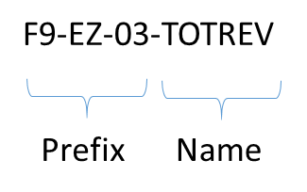
Variable Naming Conventions

Slide 9
Variable Name Prefix:
In order to create a prefix,
First, assign a two-character code for the FORM or SCHEDULE using “F9” for Form 990 or “SA”, “SB”, “SC” for Schedule A, Schedule B, Schedule C, etc.
Second, assign a two-character code for the scope of the variable:
Use “PC” for variables only found on Form 990-PC or for Schedules that only pertain to 990-PC filers.
Use “EZ” for variables only found on Form 990-EZ.
Use “PZ” for variables on both the EZ and PC forms, and for Schedules relevant to both EZ and PC filers.
Third, reference the Part and Line of the 990 where the variable is located.
Use “00” (zero-zero) for header info.
Use “01” (zero-one) for Part I, “02” (zero-two) for Part II, etc.
If the variable occurs on both the PC and the EZ forms, use the PC location.
For example:
F9-PZ-03 refers to a variable found on Form 990, the variable exists both on the PC and the EZ versions of the form, and it is located on Part III of the form.
SD-PC-06 refers to a variable found on Scheduled D, only 990-PC filers have to complete Schedule D so it is not relevant to the EZ filers, and the variables is on Part VI of the form.

Slide 10
Variable Name:
Select a concise, descriptive name for the variable, up to 12 letters long.
Use ALL CAPS.
Separate the prefix and the variable name by a dash.
Examples:
F9-EZ-03-TOTREV
Form 990, Version 990-EZ only, variable is located in Part III
F9-PZ-09-BOARDMEMBER
Form 990, Versions 990-PC and 990-EZ, variable is located in Part IX of the PC form
SB-PC-03-LOBBYEXP
Schedule B, Only 990-PC filers can submit Schedule B, variable is located on Part III

Slide 11
Location Codes:
The location code indicates where the fields are located on the Form 990 or Schedule. These are included in the data dictionary so that the user can reference the original form if necessary.
FORM 990
F990-PC-PART-03-LINE-01 F990-EZ-PART-11-LINE-04C F990-PC-PART-03-SECTION-A-LINE-09 F990-EZ-PART-11-SECTION-B-LINE-04A F990-EZ-PART-11-SECTION-B-LINE-08-COL-A SCHEDULES SCHED-A-PART-03-LINE-12B SCHED-B-PART-02-SECTION-B-LINE-04

Slide 12
Location Codes:
Use the following conventions for location codes – this will ensure that they are machine-readable and can be easily searched.
Specify the relevant Form or Schedule using “F990-PC”, “F990-EZ”, or “SCHED-X”.
Specify the location on the form using PART-##. Use 01, 02, up to 09 for numbers less than 10.
Use PART-00 (zero-zero) for any variables that occur in headers or footers, not numbered sections.
If the form part is split into sections, include as SECTION-X.
If a line exists, record as LINE-01 or LINE-01A.
If columns exists, match column names using COL-A, COL-B, etc.
Include enough info to ensure the location code is unique.
In a couple of instances you may need to create section codes, even though they are not explicit on the forms but line numbers reset within a form Part.

Slide 13


Master Plan:
(Nonprofit Open Data Collective)
Master Concordance File
Build Scripts
Documentation
Data tables
Data dictionary
(Blueprints)
(Datasets)

Slide 14
We are documenting and posting the following open data assets:
IRS E-Filer Database: All nonprofit 990 data that is filed electronically, about 60% of nonprofits.
Index of all E-Filers from 2009 to Present: A list of all organizations that have electronically filed each year.
Current Exempt Organizations: The current list of all tax-exempt organizations.
IRS Business Master File: Organizational characteristics of all current exempt organizations.
990N Postcard Filers: Data on nonprofits that are small enough to file the abbreviated “postcard” version of the 990 form.
IRS Automatic Revocations:” Database of nonprofits that had their tax exempt status revoked for failing to file.
Organizations Granted Tax Exempt Status through 1023-EZ Form: Data filed electronically on the new shorter 1023-EZ application for 501(c) status.

